Slide 1



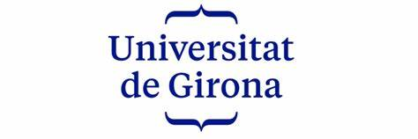
Semantic Nuclei Segmentation for Medical Image Analysis using U-Net: An Exploration and Evaluation
2018 DATA SCIENCE BOWL – NUCLEI SEGMENTATION CHALLENGE:
Presentation by:
Daniel Tweneboah Anyimadu

Slide 2
ABSTRACT
The studies is carried out on the 2018 data science bowl dataset. The project involves data acquisition and exploration, preprocessing, U-Net architecture implementation for image segmentation, and performance evaluation.
Validation dataset results are assessed using intersection over union (IoU), average precision (AP) and accuracy.
The obtained results are as follows: IoU : 0.8624, mAP : 0.7746 and accuracy : 0.9668
This study presents a comprehensive exploration and evaluation of a Semantic Nuclei Segmentation framework utilizing U-Net architecture for medical image analysis.
The primary goal is to automate nucleus detection in medical images, with potential implications for accelerating disease research and drug development.
2

Slide 3
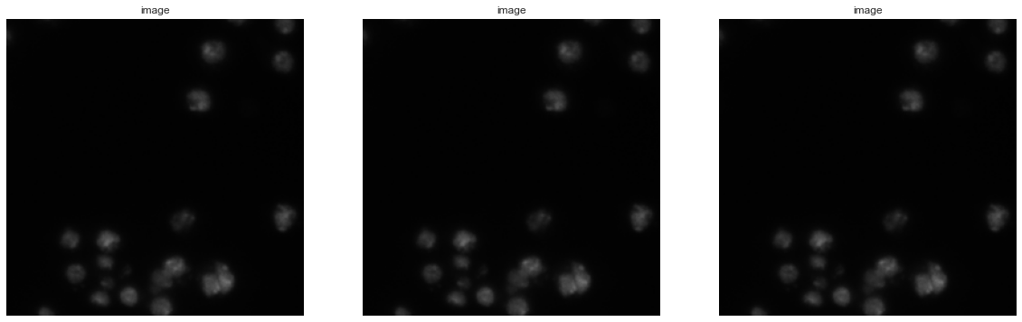
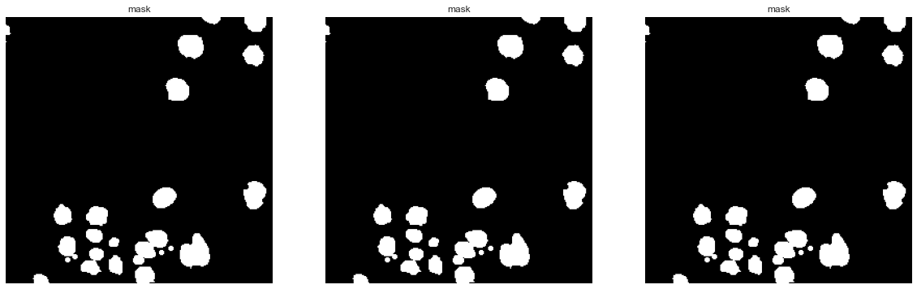
Exploratory Data Analysis (EDA)
A visualization of Input & Mask (Groundtruth) Images :
3

Slide 4
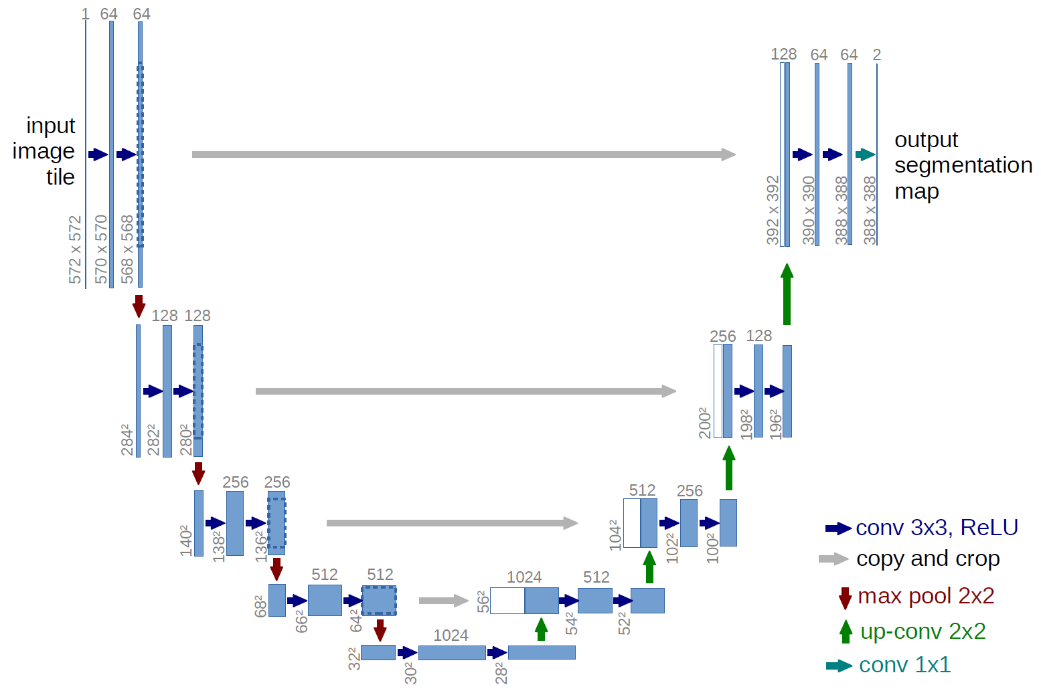
U-Net Architecture Implementation
U-Net Architecture:
This is designed to automate the classification and segmentation of individual nucleus within input images containing multiple nuclei.
4

Slide 5
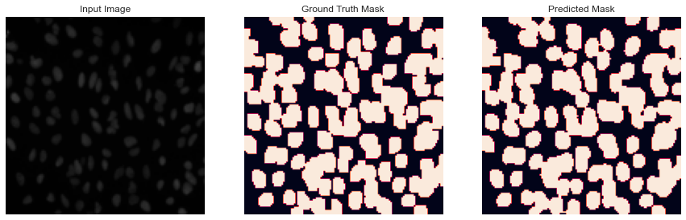
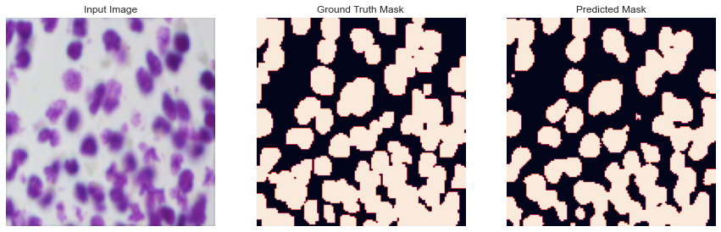
Comparative Analysis of Input Image, Groundtruth Mask & Predicted Mask
Training Images :
Validation Images :
5

Slide 6
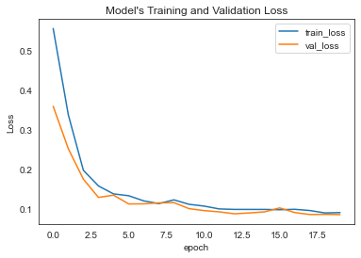
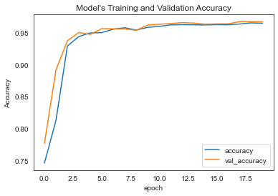
PERFORMANCE EVALUATION OF U-NET MODEL
MODEL | IoU (TEST) | PRECISION (TEST) | mAP (TEST) | ACCURACY (TEST)
U-Net | 0.8624 | 0.7746 | 0.7746 | 0.9668
Semantic nuclei segmentation with U-Net holds promise for transforming medical research as attested by the obtained results.
6

